Slide 1

Car Pooling System
1.Mayur Jain (20104024)
2.Madhur Dukhande (20104014)
3.Aryan Amin (20104071)
4.Anmol Ahirwar (20104131)
Project Guide
Ms. Rucha Kulkarni

Slide 2
Contents
Introduction
Objectives
Scope
Features / Functionality
Project Outcomes
Technology Stack
Block Diagram if applicable

Slide 3
1. Introduction
The carpooling system is a web-based application is to provide us with a simple riding platform between the car owner and car user. Carpooling (also known as car-sharing, ride-sharing and lift sharing), is the sharing of car journeys so that more than one person travels in a car.
Carpooling has become a practical, cheap and stress-free way to move around.

Slide 4
Problem Identified :
Some people may recognize that they do not want to engage in carpooling any longer since they want to be more flexible.
passengers might join a carpool with irresponsible drivers which could lead to serious car accidents.
Solution Proposed :
Through the use of carpools, there would be fewer cars on the streets and the chances to get stuck in traffic jams might be lower due to that.
Carpooling would be an effective measure against noise pollution and fewer cars would be used.

Slide 5
2. Objectives
To reduce overall traffic congestion and peak hour congestion on the roads.
To reduce single occupancy car trips by implementing car pooling system.
To promote alternative modes of transport.
To improve parking in areas that are experiencing parking congestion.
To save money by sharing the cost of driving one car.
To reduce pollution and carbon dioxide emissions.
To reduce driving-related stress for participants.

Slide 6
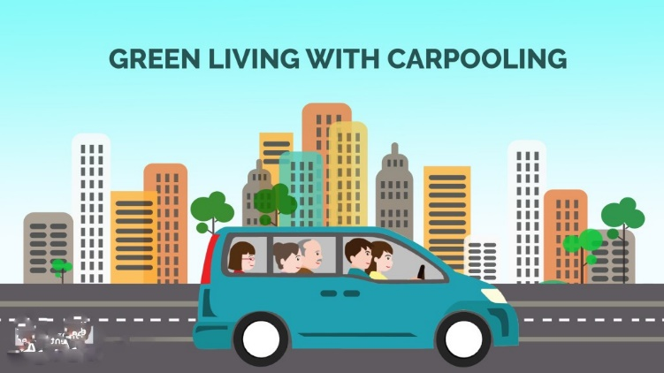
3. Scope
The Car Pooling System provides an eco-friendly way to travel which also provides an opportunity to meet new people and passengers will make their trip with a reliable automobile.

Slide 7
4. Feature /Functionality
1.EMPLOYER BENEFITS:
▪ Reduced need for parking
▪Financial and tax benefits for employers
2. SOCIETAL BENEFITS:
▪ Reduced vehicle miles traveled
▪Cost savings for public agencies and employers.
3. TECHNOLOGICAL TRENDS:
▪ Growth of location-based navigation services and data sharing.

Slide 8
5. Outcome of Project
Carpooling will save YOU money.
Carpooling is better for the environment.
Carpooling is convenient.
Get to meet new people

Slide 9
6. Technology Stack
Developed front end ( GUI ) & Backend (Database if applicable)
Back End:
MYSQL Ver 8.0.26
Front End:
1. Tkinter (Visual studio code)

Slide 10
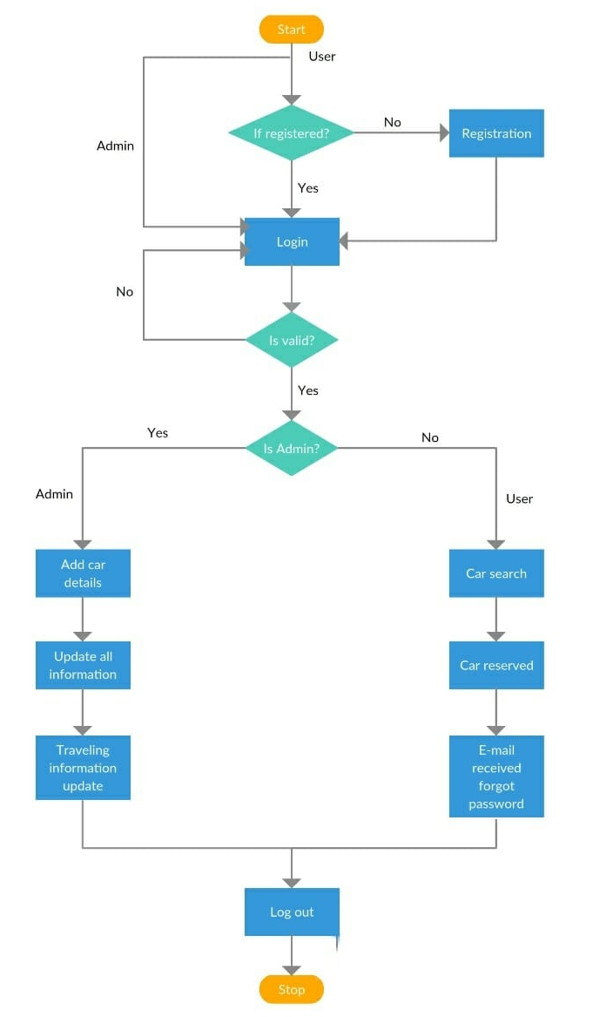
Flowchart

Slide 11
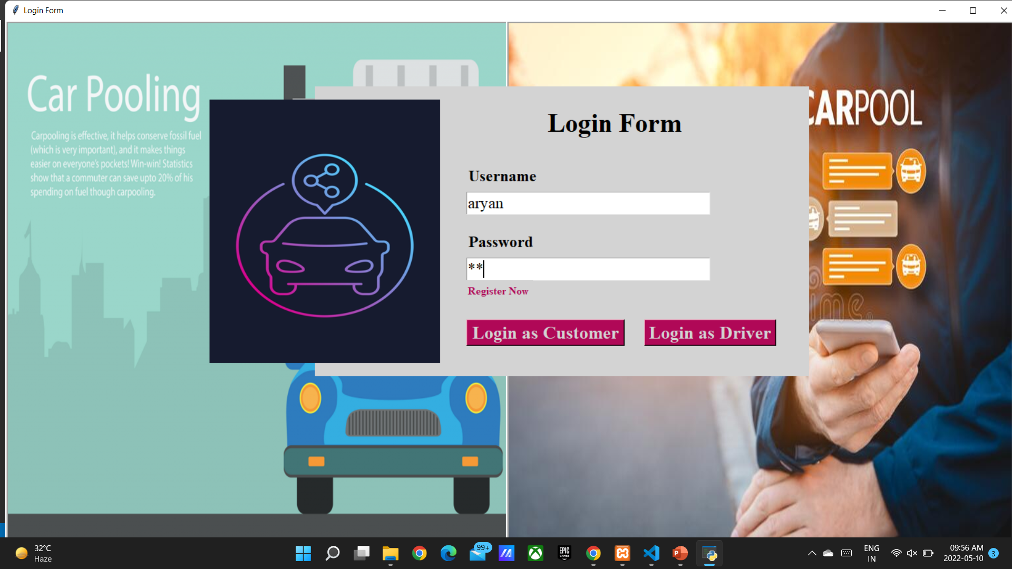
Login Form

Slide 12
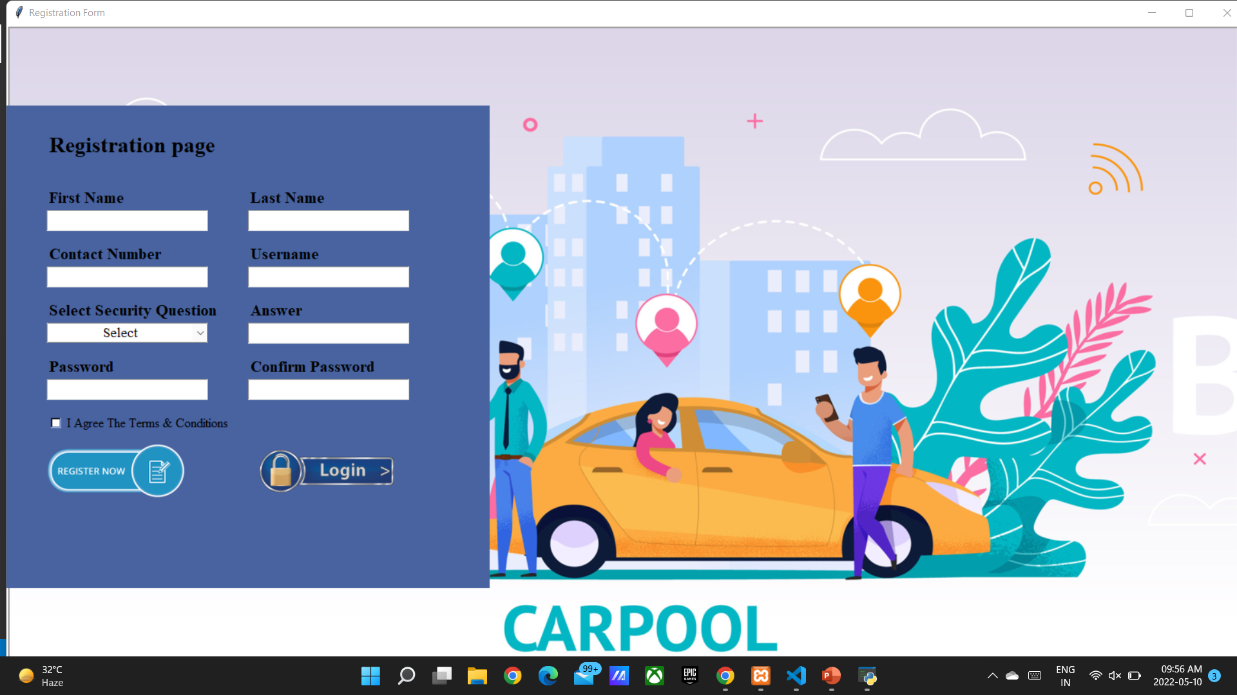
Registration Form

Slide 13
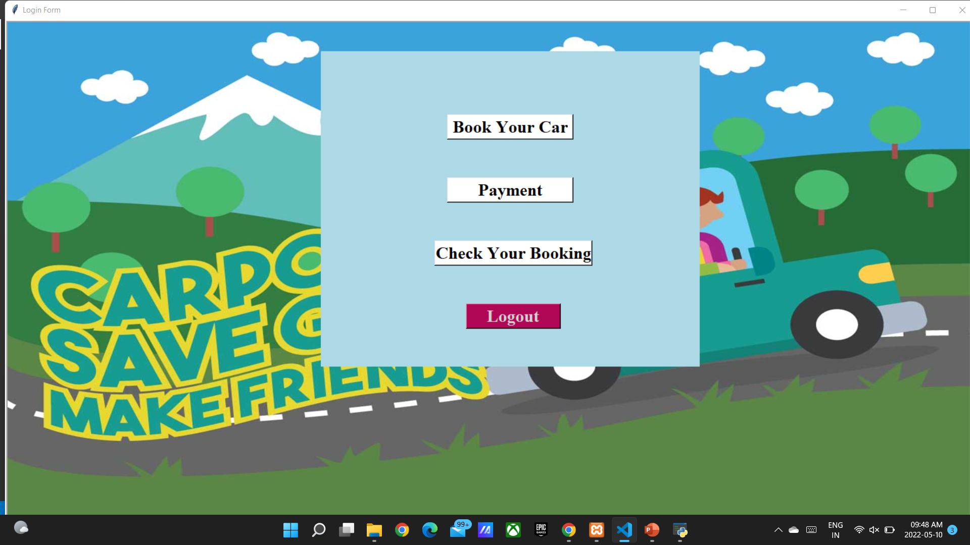
Homepage for Customers

Slide 14
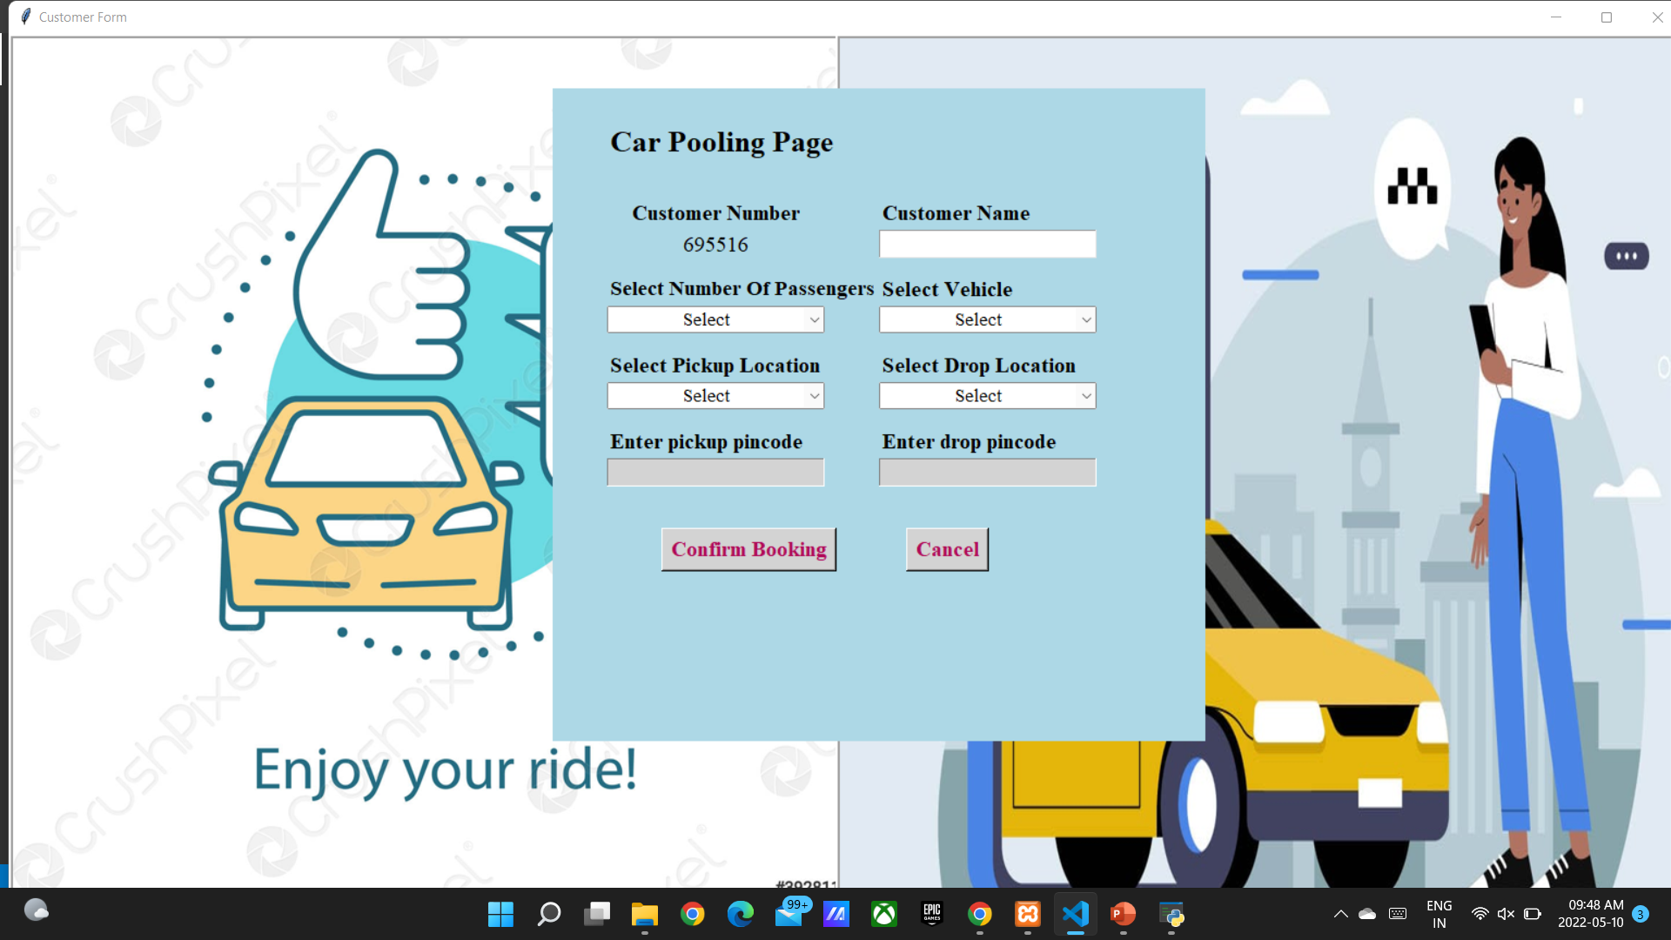
Book Your Car

Slide 15
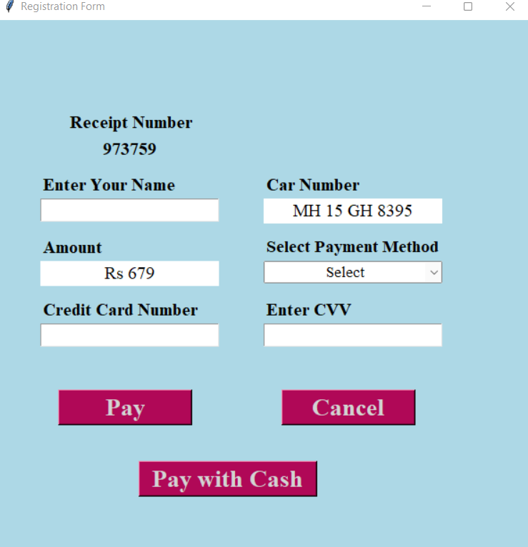
Payment Page

Slide 16
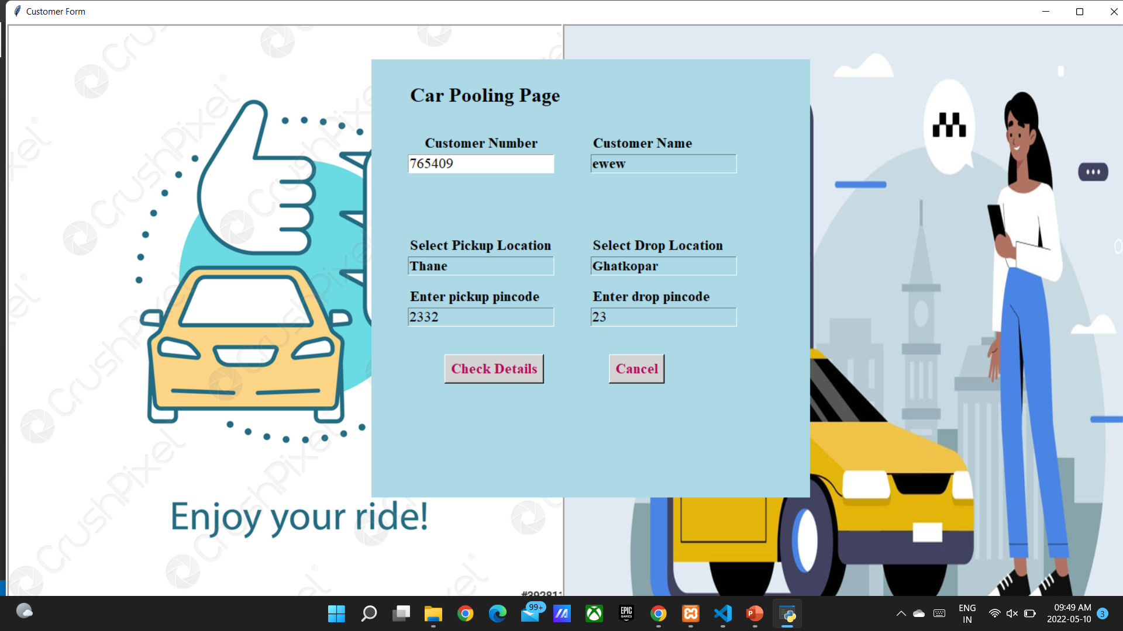
Check Your Details

Slide 17
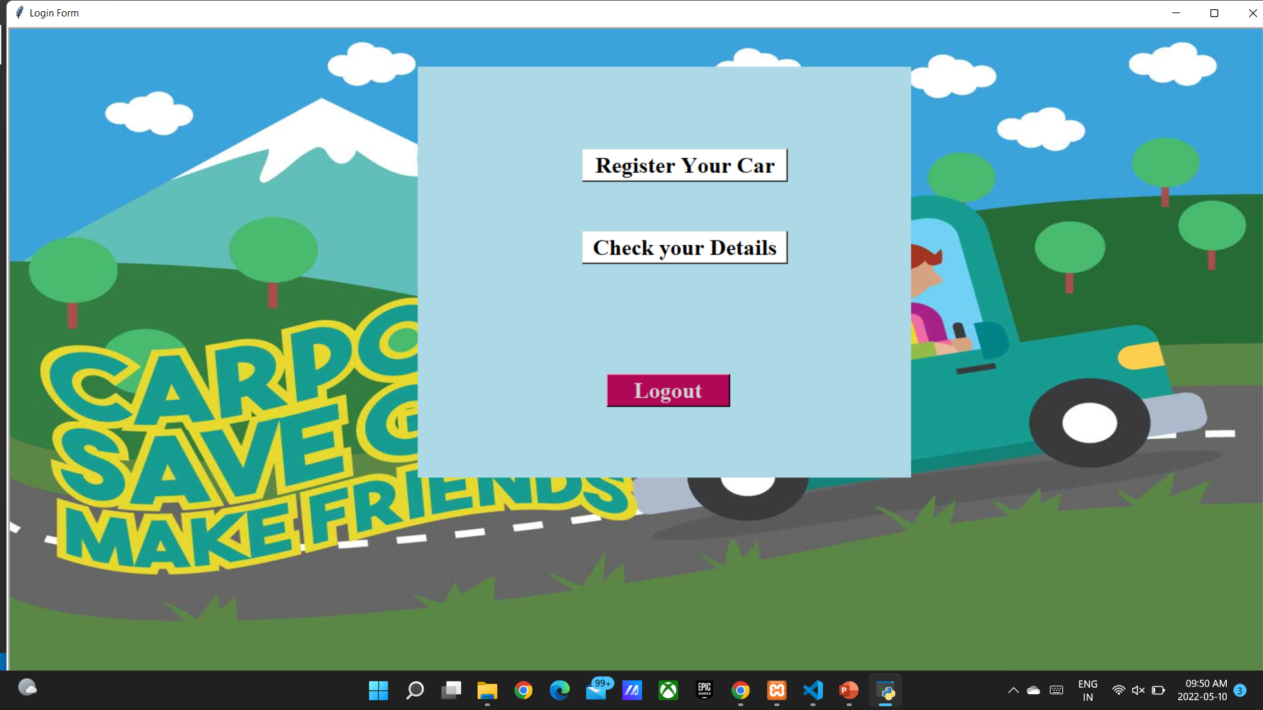
Driver Homepage

Slide 18

Driver Registration

Slide 19

Driver Details

Slide 20
Thank You...!!

